Slide 1

Tutorial 3: Lab1 & Classes & UML Diagrams
COMP 249 CCCE
Object-Oriented Programming II

Slide 2
Tasks for Today
Running Terminal in IDE
Lab 1 Review & Discussion
Classes & Inheritance
UML Diagrams with Examples

Slide 3
Command Line Commands
Know how to access command line on your machine
Windows: Type cmd in search
Mac: Open Launchpad, search Terminal and select it
Get familiar with basic commands:
dir : List contents of the directory -> Windows
ls : List contents of the directory -> Mac &Linux
mkdir directory_name : Creates a new directory/file
cd directory_name : Go to the specified directory
cd .. : Moves up one directory level
↑ : ‘Up’ key on keyboard shows previous command
notepad file_name.java : opens text editor -> Windows
nano file_name.java : opens text editor -> Mac &Linux
java –version : Prints the current version installed
javac file_name.java: Compiles into byte code & outputs nothing if no errors
java file_name: Runs the code
Note: there is no .java extension!

Slide 4
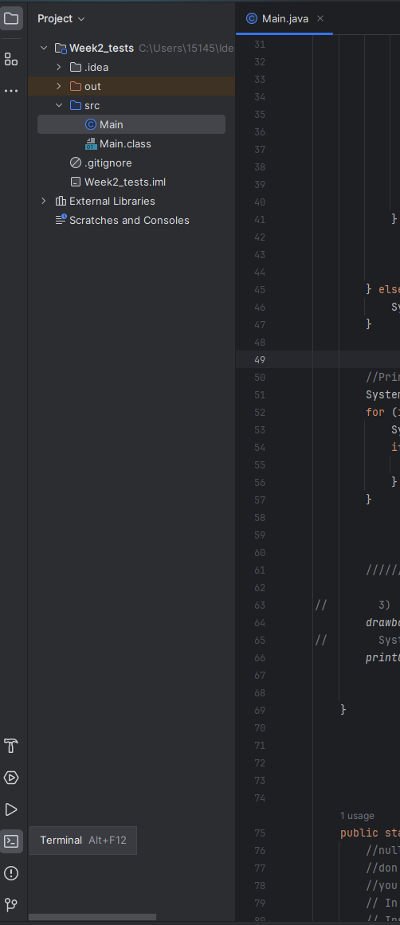
Running Terminal from IDE
Intellij
https://www.jetbrains.com/help/idea/terminal-emulator.html#new_session
Steps
Open Terminal in the bottom left corner
Locate and navigate to src directory (src should be your current directory)
Compile and run Main.java using javac and java commands:
javac file_name.java
java file_name

Slide 5
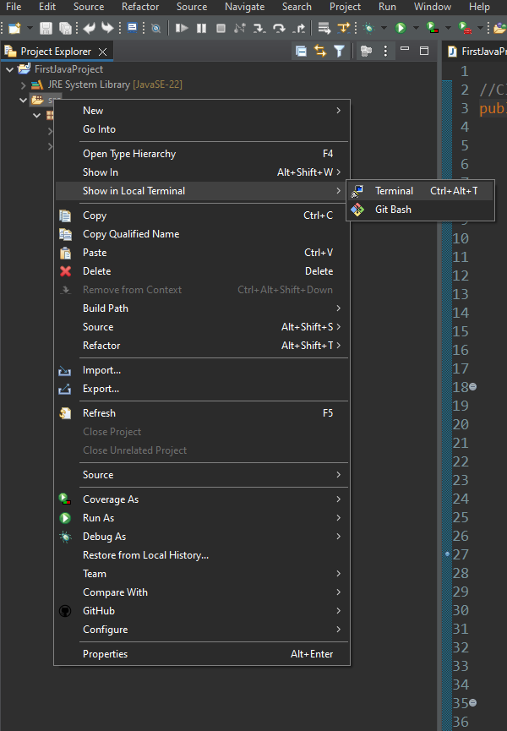
Running Terminal from IDE
Eclipse
https://marketplace.eclipse.org/free-tagging/terminal#:~:text=Terminal%20inside%20Eclipse.-,Just%20press%20Ctrl%2BAlt%2BT%20to%20open%20a,local%20command%20prompt%20(Terminal)
Steps
Open Terminal by right-clicking on src folder and selecting ‘Show in Local Terminal’ Note: Your current directory is src directory so you can run your java program right away
Compile and run Main.java using javac and java commands:
javac file_name.java
java file_name

Slide 6
Lab 1: Tic-Tac-Toe Win Checker
Read carefully, access what is the problem, what information you have, what do you need to do
Divide into smaller tasks (build proper directory structure, read from terminal, check win conditions, print output)
Remember TicTacToe example in class
Write pseudo-code or simply what parts of your program will do what (takes a couple of minutes)
Write code
Run DebugRunner
* Code Example

Slide 7
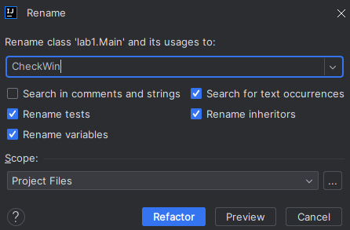
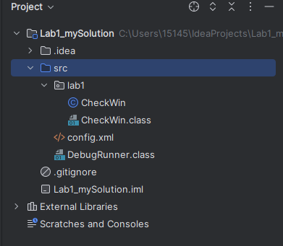
Lab 1: Running CheckWin & DebugRunner
CheckWin
In IDE create New Project
Right-click on src folder, select New -> Package, name it lab1
Drag Main into lab1 package, select Refactor (right-click if it does not appear) and rename to CheckWin
Repeat the steps from A0 to compile and run CheckWin
DebugRunner
Copy/Extract your files from zip folder into src directory of your project
Run DebugRunner in terminal

Slide 8
Assignment 1: Othello Game
Game Instructions:
https://www.youtube.com/watch?v=xDnYEOsjZnM&ab_channel=TripleSGames
Game Online:
https://www.eothello.com/

Slide 9
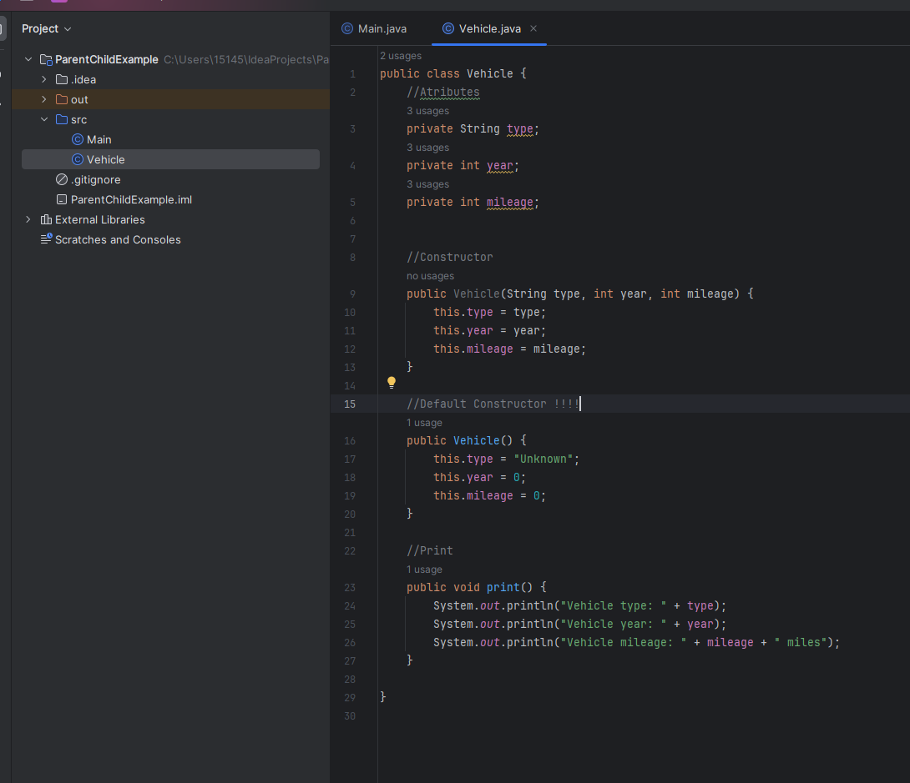
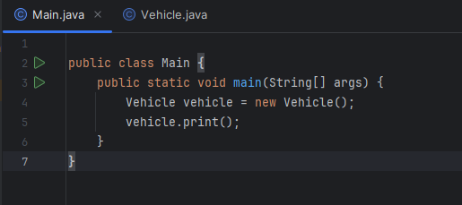
Class & Inheritance
Class is a blueprint for an object – use it to create many instances of that class (f.e. house blueprint)
In OOP we use classes to create objects (! Class is not an object)
The new operator instantiates objects, it creates new instances of a class.
Constructor is a special method that initializes the instance of that class

Slide 10
Class & Inheritance
Inheritance is the ability to define a new class that has the same instance variables and methods of an existing class.
The extends keyword is used to extend the parent class or inherit from class
Types of classes:
Superclass (parent)
Subclass (child)
Constructors are not inherited
F.e. In this simple conceptual UML diagram the SUV class (subclass) inherits the attributes and methods from the Vehicle class (superclass)
* Code Example
Vehicle
SUV
Sedan

Slide 11
UML Class Diagram
Unified Modeling Language (UML) – type of static structure diagram that describes the structure of system or program
UML is an international standart
UML Class diagram – graphical notation used to design and visualize object-oriented systems, detail the attributes and methods classes have and the relationships between classes
Objected oriented system – software model that uses objects (or data) to represents the application
Class Diagram:
has to be detailed
is an outline of your program design
is an organization tool for your program

Slide 12
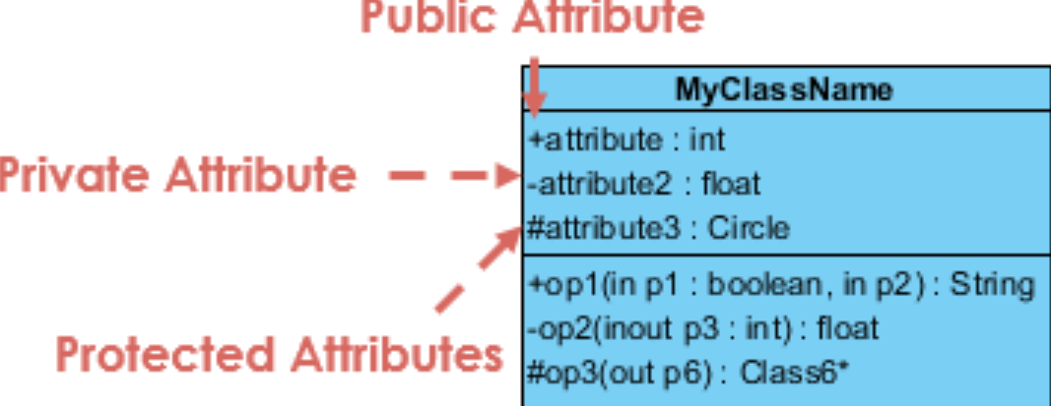
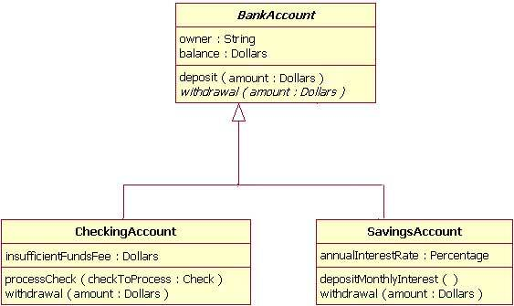
UML Class Diagram
UML notation
Class name written in bold ;
Abstract class name - in italic
Attributes & Methods (Operations) written in lowercase (camelCase):
+ Public
- Private
# Protected : accessible within its namespace (a group of classes and packages).
UML abstract class is a class without any instances
F.e. BankAccount class provides the abstract operation signature of withdrawal and the two child classes of CheckingAccount and SavingsAccount each implement their own version of that operation
https://www.visual-paradigm.com/guide/uml-unified-modeling-language/uml-class-diagram-tutorial/
https://developer.ibm.com/articles/the-class-diagram/#abstract-classes-and-operations8

Slide 13
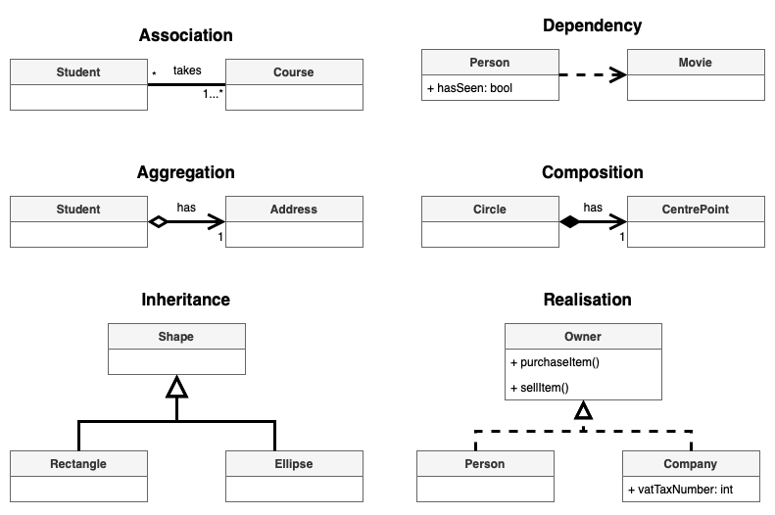
UML Class Diagram
Relationships between Classes:
Association – class knows about relationship with other class (f.e. student enroll in class)
Bidirectional Association - classes are aware of one another
Dependency - definition of class 2 depends on definition of class 1 (changes in class 1 effect class 2)
Aggregation – class 2 is part of class 1 but the class 2 can be independent (Library and Book)
Composition – class 2 cannot exist without class 1 (composed of)
Inheritance – class 2 and 3 are subclasses (children) of parent class, they extend the parent
Realization – class 1 is blueprint for class 2 and 3
https://www.drawio.com/blog/uml-class-diagrams

Slide 14
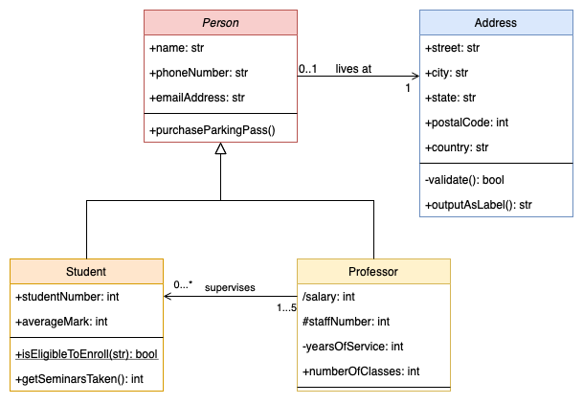
UML Class Diagram: Examples
Association
Inheritance
Association
https://www.drawio.com/blog/uml-class-diagrams

Slide 15
UML Class Diagram : TicTacToe example
Draw.io – to create your UML diagrams online:
https://app.diagrams.net/#G1t44PTCwD17xYg69WYoB36IaXUwditWKr#%7B%22pageId%22%3A%22c4acf3e9-155e-7222-9cf6-157b1a14988f%22%7D
Example of classes we might need: Board, Player, Main
Board (TicTacToe)
Attributes (- private): board: char[], currentPlayer: Player
Methods(+ public): printBoard(): void, getWin(): Player
Player
Attributes (- private): name: String, symbol: char
Methods(+ public): makeMove(): void
Main (TicTacToeDriver)
Methods(+ public): initializeBoard() : void, initializePlayers() : void, startGame(): void

Slide 16
UML Class Diagram
More details on UML Class Diagram
https://www.youtube.com/watch?v=WnMQ8HlmeXc&t=170s&ab_channel=freeCodeCamp.org

Slide 17

Any Questions?

Slide 18
References
Blog - Create UML class diagrams. (n.d.). https://www.drawio.com/blog/uml-class-diagrams
IBM Developer. (n.d.). https://developer.ibm.com/articles/the-class-diagram/#abstract-classes-and-operations8
Think Java How to Think Like a Computer Scientist

